Slide 1
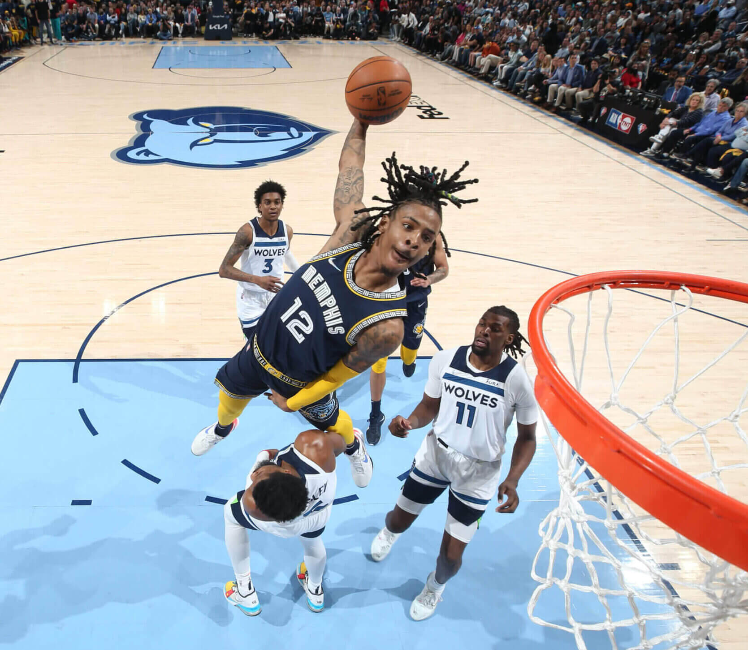
Are taller NBA players more successful?
Heather Moore
DSC 530
Term Project

Slide 2
The Dataset
Data: All NBA & ABA Players Bio, Stats, & Accolades by Ryan Schubert
https://www.kaggle.com/datasets/ryanschubertds/all-nba-aba-players-bio-stats-accolades
Contains data from all NBA and ABA players stats from 1946 to 2022
Columns 39, Rows: 5023
Data is pulled from basketball-reference.com
Current of June 29th, 2022

Slide 3
Variable
Player: Player Name
From: Year that the player made their debut
To: Final year of player’s career
Years: Total number of years played
Pos: Position played
Ht: Height(feet-inches
Wt: Weight (lbs)
G: Total number of games played
Pts: Career average points per game
All Star: All Start Appearances
TRB: Career average total rebounds(offensive/defensive) per game
AST: Career average assists per game
FG%: Career average field goal percentage
FG3%: Career Average 3-point field goal percentages
FT%: Career average free throw percentage
eFG%: Career average effective field goal percentage
PER: Career Average player efficiency rating
WS: Total Career Wins

Slide 4
Variable cont.
All NBA: All NBA team appearances
All ABA: All ABA team appearances
All Rookie: All Rookie team appearance
All Defensive: All defensive
BLK Champ: Times led the league in blocks
STL Champ: Times led the league in steals
TRB Champ: Times led the league in rebounds
AST Champ: Times led the league in assist
Finals MVP: Times won a finals MVP award
MVP: Times won the MVP awards
NBA 75 Team: if player was included on NBA 75th anniversary team
Scoring Champ: Times led the league in scoring
Most Improved: Times won the Most Improved Player awards
Sixth Man: Times won the Sixth Man of the Year award
DPOY: Times won the Defensive Player of the Year award
ROY: Times won the Rookie of the Year award
As MVP: Times won the All-Star game MVP award
CF MVP: Times won a conference MVP award
Championships: Number of champions won
ABA All Time Team: If player was included on the ABA All Time team

Slide 5
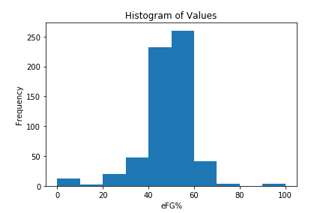
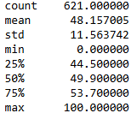
Histogram: eFG% Career Average Effective Goal Percentage
The effective goal percentage is the number of shots made divided by shots attempted
3-point shots are given added value since they are more difficult
The average eFG% for all players is 40-50%. The taller players are considered average in their field goal percentage.
Outliers: Players who have only taken very few shots and made them or missed them. Usually, players who had short careers and no playing time.

Slide 6
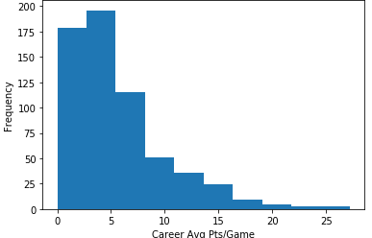
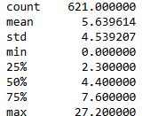
Career Average Points Per Game
Measure the average number of points scored in a game over their career
Most NBA players score about 10 points per game on average. Here we see the taller players score less on than the NBA average.
Outliers: There are a lot of players who had short careers and no playing time. Thus, making their points per game average very low

Slide 7
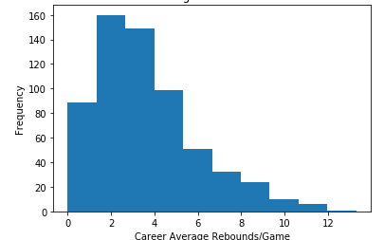
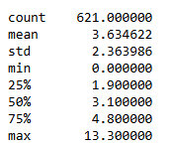
Career Average Rebounds Per Game
Measure the average number of rebounds in a game over their career
The rebound average for the league is around 8 per game. In the histogram and summary statistics, taller NBA player are below the league average.
Outliers: There are not outliers here

Slide 8
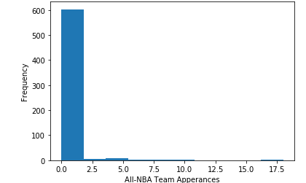
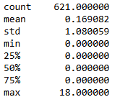
All-Star Team Appearances
Players are considered for the team when they have had an amazing season performance
Being chosen for an All-Start is a priviage based on the best performers of the year. Going more than one time is considered to be an honor.
Outliers: The outlier in this performance is Lebron James who has appeared in 18 all-start games since 2022. Usually, the very well-known player are chosen for this game

Slide 9
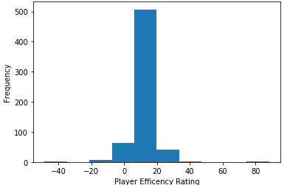
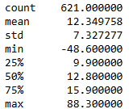
Player Efficiency Rating
Rating of a players per minute productivity in a game with their specific team; summarizes a player’s statistical accomplishments into a single number
The average PER for all players 15. The taller players do fall below the league average. Only the top 75% of these players are considered average
Outliers: The min and the max for this variable comes from two individuals that played for one year with very little playing time. It depends on how many minutes were played and points scored

Slide 10
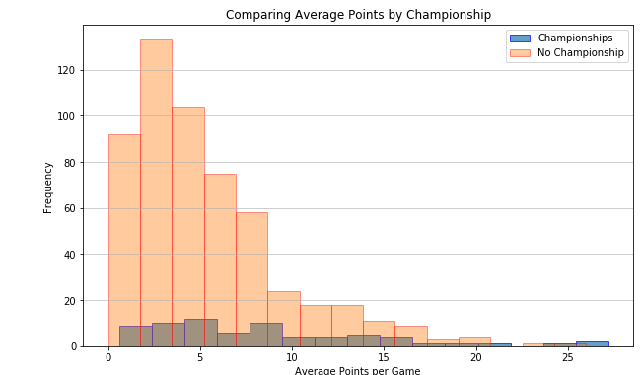
Average Points per Game with(out) a Championship
This graph is comparing players who have won a championship versus those who have not
It looks like the two scenarios are following a similar pattern and championships do not influence average number of points per game for taller players.

Slide 11
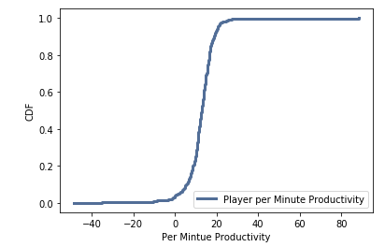
CDF: Player per Minute Productivity
A common theme with the taller is players is that their careers tend to be pretty short. Which leads to less playing time and smaller per minute productivity.
The average PER for most NBA players is 15. There is a sharp increase in the slope indicated that most of the taller players fall within the 0-20 score.
The flat end of the graphs indicates that there are very few players with very high or very low PER.

Slide 12
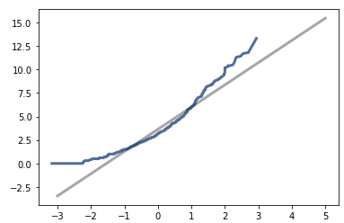
Analytical Distribution on Total Career Rebounds
X-axis: Total Career Rebounds
The tails of this plot flair out which show that there may be more observations at the higher or lower end
In terms of the analysis, this means that the bulk of the taller NBA players tend to have a smaller number of rebounds

Slide 13
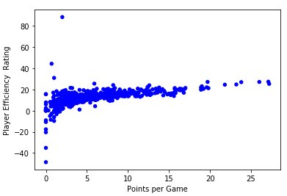
Scatter Plots: Average Points per Game vs PER
Does the average number of points scored per game correlated with the player efficiency rating?
According to the graph, there seems to be a slight positive correlation between the variables
Pearson Correlation: 0.528
The Pearson Correlation just reiterates that there is a slight positive relationship between the variables
Overall, the average number of points per game does not cause a big impact on a player efficiency rating to increase

Slide 14
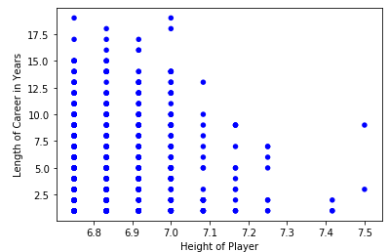
Scatter Plot: Height vs Career Length
Does the height of the player increase the length of their career?
This graph looks like there would be a negative relationship but, I believe there is no very obvious relationship. The lack of dots are just multiple observations on top of each other.
Pearson Correlation: -0.0256
According to the Pearson Correlation, it shows that there is very little correlation between the variables.
With the Pearson Correlation, we could say that there is little to no linear relationship between these two variables

Slide 15
Hypothesis Test: Points by Position
For the hypothesis test, I conducted the permutation test to see the relationship between positions :
Groups
Group 1: Center
Null-hypothesis: Centers tend to score more points than Forwards
Group 2: Forward
Alternative hypothesis: Centers do not score more points than Forwards
Calculated the observed difference: -0.5174
Permutation:1000
Calculate the p-value : 0.1527
Since the p-value is above the Threshold of 0.05, the relationship is not significant and we shouldn’t reject the null hypothesis.

Slide 16
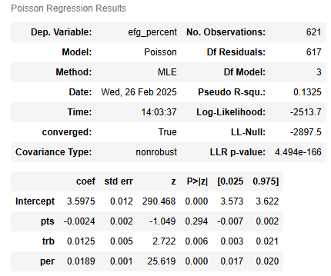
Regression Analysis
Variables:
Y= career average effective field goal percentage
Xs:
Career Average Points per Game
Total Career Rebounds
Player Efficiency Rating (PER)
Results
The Pseudo R^2: 0.13
This indicates that model only explains only a small portion of the variance and is not a great fit for the data
The p-values do show that total rebounds, and player efficiency rating would be considered significant to the model. Their coefficients are not very influential.

Slide 17
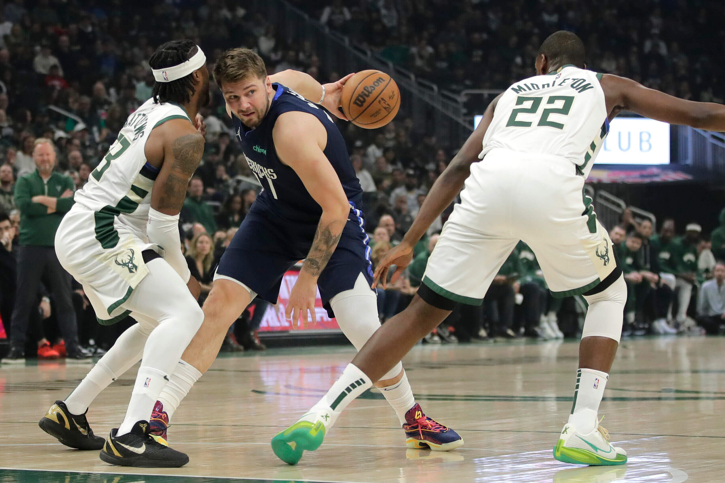
Conclusion
The goal of this analysis was to see if taller NBA players are more successful. My findings would indicate that taller NBA players do not have more successful.
In the analysis that was ran, the taller players were either on par or fell below the league average which means that their height has little effect on the success of their career when compared to league standards as well as relationship with other variables that dictate success.

Slide 18
Sources
https://www.basketball-reference.com/leaders/trb_per_g_career.html
https://www.espn.com/nba/story/_/id/41796364/nba-rank-2024-rankings-top-10-players-league
https://statathlon.com/four-factors-basketball-success/
https://jr.nba.com/basictraditional-stats-vs-advanced-stats/
https://www.nba.com/stats/help/faq
https://hoopsking.com/blogs/default-blog/exploring-efg-what-is-effective-field-goal-percentage#:~:text=Key%20Takeaway:%20In%20the%20basketball,to%2
https://www.espn.com/nba/columns/story?columnist=hollinger_john&id=2850240
https://www.sportskeeda.com/basketball/news-how-all-nba-teams-selected-selection-process-details-explored
Photos
http://nytimes.com/athletic/3269879/2022/04/29/aprils-best-nba-photos/

